Slide 1
Attention Augmented Convolutional Networks

Slide 2
Paper Details
Paper Title: Attention Augmented Convolutional Networks
Publication Date: International Conference on Computer Vision (ICCV), 2019
Publisher: Irwan Bello, Barret Zoph, Ashish Vaswani, Jonathon Shlens
Affiliation: Google Brain

Slide 3
Objectives
Image Classifications
simpler task than that from DERT
Notes:
The goal is to classify the image by assigning it to a specific label. Typically, Image Classification refers to images in which only one object appears and is analyzed. In contrast, object detection involves both classification and localization tasks, and is used to analyze more realistic cases in which multiple objects may exist in an image.

Slide 4
Motivation
Convolutional Neural Networks
locality via a limited receptive field + translation equivariance via weight sharing
Not capture the global contexts
Self-attention
Notes:
Convolutional Neural Networks have enjoyed sucess in many computer vision applications. The design of the layer imposes two directions. …. But it can not capture the global contexts because of local nature of the kernels.
Self-attention on the other hand can capture the long range interactions. In this paper, they consider the use of self-attention for discriminative visual tasks as an alternative to convolutions. But at the end, thy figure out the best results are obtained when combining both of them. We will talk about it later

Slide 5
Motivation
Convolutional Neural Networks
locality via a limited receptive field + translation equivariance via weight sharing
Not capture the global contexts
Self-attention
Notes:
Convolutional Neural Networks have enjoyed sucess in many computer vision applications. The design of the layer imposes two directions. …. But it can not capture the global contexts because of local nature of the kernels.
Self-attention on the other hand can capture the long range interactions. In this paper, they consider the use of self-attention for discriminative visual tasks as an alternative to convolutions. But at the end, thy figure out the best results are obtained when combining both of them. We will talk about it later

Slide 6
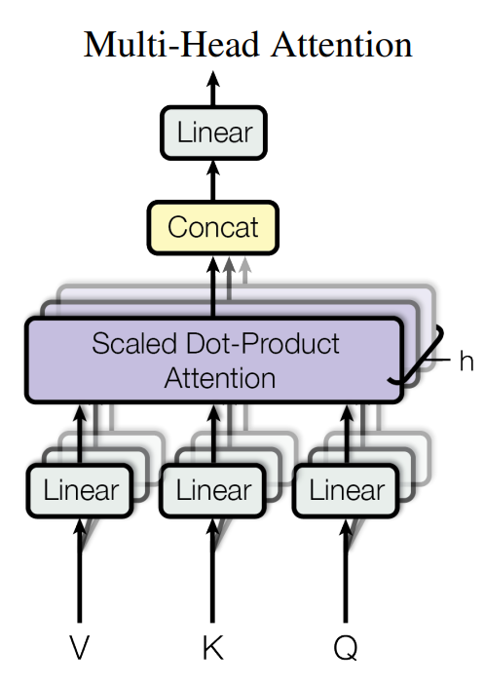
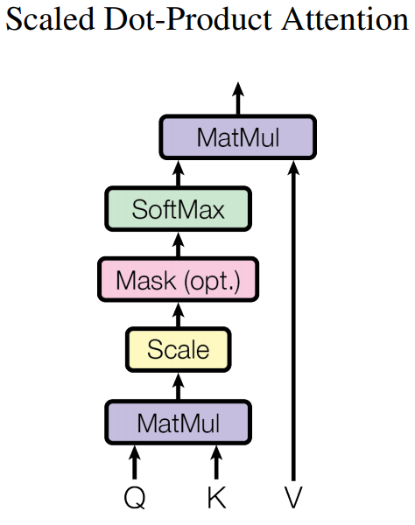

Architechture
Self-attention over images
flatten
tensor
multihead attention
Notes:
H, W and Fin refer to the height, width and number of input filters of an activation map. They omit the batch dimension for simplicity.

Slide 7
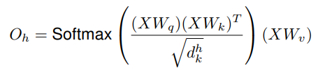






Architechture
Self-attention over images
Learned linear Transformation
reshape
Notes:
H, W and Fin refer to the height, width and number of input filters of an activation map. They omit the batch dimension for simplicity. The outputs of all heads are then concatenated and projected. It was written as MHA(X). MHA(X) is then reshaped into a tensor of shape (H, W, dv) to match the original spatial dimensions. Nh, dv and dk respectively refer the number of heads, the depth of values and the depth of queries and keys in multihead-attention (MHA). We further assume that Nh divides dv and dk evenly and denote d h v and d h k the depth of values and queries/keys per attention head.

Slide 8
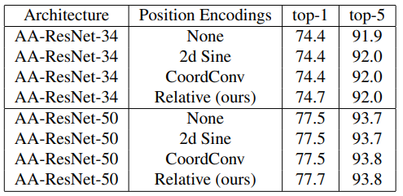
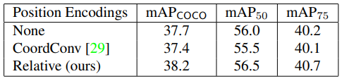
Architechture
Self-attention over images
Two-dimensional Positional Encodings
Absolute Encoding
Relative Encoding
Notes:
Without explicit information about positions, self-attention is permutation equivariant. We hypothesize that this is because such positional encodings, while not permutation equivariant, do not satisfy translation equivariance, which is a desirable property when dealing with images. Experiments demonstrate that our relative position encodings become increasingly more important as the architecture employs more attentional channels. We apply Attention Augmentation using the same hyperparameters as 4.2 with the following different position encoding schemes: 1) The position-unaware version of self-attention (referred to as None), 2) a two-dimensional implementation of the sinusoidal positional waves (referred to as 2d Sine) as used in [32], 3) CoordConv [29] for which we concatenate (x,y,r) coordinate channels to the inputs of the attention function, and 4) our proposed two-dimensional relative position encodings (referred to as Relative). Our experiments also reveal that the sinusoidal encodings and the coordinate convolution do not provide improvements over the positionunaware version of Attention Augmentation

Slide 9

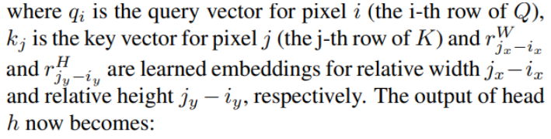
Architechture
Self-attention over images
Two-dimensional Positional Encodings
Absolute Encoding
Relative Encoding
Notes:
We implement two-dimensional relative self-attention by independently adding relative height information and relative width information. The attention logit for how much pixel i = (ix, iy) attends to pixel j = (jx, jy) is computed as:
where S rel H , Srel W ∈ R HW×HW are matrices of relative position logits along height and width dimensions. The relative positional embeeddings r H and rW are learned and shared across heads but not layers.

Slide 10
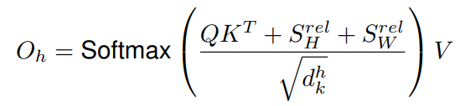
Architechture
Self-attention over images
Two-dimensional Positional Encodings
Absolute Encoding
Relative Encoding
Notes:
The output of head h now is computed as:
where S rel H , Srel W ∈ R HW×HW are matrices of relative position logits along height and width dimensions. The relative positional embeeddings r H and rW are learned and shared across heads but not layers.

Slide 11
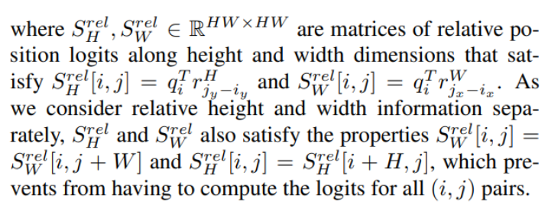
Architechture
Self-attention over images
Two-dimensional Positional Encodings
Absolute Encoding
Relative Encoding
Notes:
The output of head h now is computed as:
where S rel H , Srel W ∈ R HW×HW are matrices of relative position logits along height and width dimensions. The relative positional embeeddings r H and rW are learned and shared across heads but not layers.

Slide 12


Architechture
Self-attention over images
Two-dimensional Positional Encodings
Absolute Encoding
Relative Encoding
Absolute Encoding
Relative Encoding
Notes:
The output of head h now is computed as:
where S rel H , Srel W ∈ R HW×HW are matrices of relative position logits along height and width dimensions. The relative positional embeeddings r H and rW are learned and shared across heads but not layers.

Slide 13



Architechture
Self-attention over images
Two-dimensional Positional Encodings
Absolute Encoding
Relative Encoding
Music transformer. In Advances in Neural Processing Systems, 2018
https://arxiv.org/pdf/1809.04281.pdf
Notes:
Instead, we extend the memory efficient relative masked attention algorithm presented in [18] to unmasked relative self-attention over 2 dimensional inputs. The relative positional embeeddings r H and rW are learned and shared across heads but not layers. For each layer, we add (2(H + W) − 2)d h k parameters to model relative distances along height and width.

Slide 14
Architecture
Self-attention over images
Attention Augmented Convolution
use an attention mechanism that can attend jointly to spatial and feature subspaces
introduce additional feature maps rather than refining them
Notes:
In contrast to these approaches, we 1) use an attention mechanism that can attend jointly to spatial and feature subspaces (each head corresponding to a feature subspace) and 2) introduce additional feature maps rather than refining them

Slide 15

Architecture
Self-attention over images
Attention Augmented Convolution
Concatening convolutional and attentional feature maps
Notes:
Formally, consider an original convolution operator with kernel size k, Fin input filters and Fout output filters. The corresponding attention augmented convolution can be written as the formel in the middle. Similarly to the convolution, the proposed attention augmented convolution 1) is equivariant to translation and 2) can readily operate on inputs of different spatial dimensions.

Slide 16
Architecture
Self-attention over images
Attention Augmented Convolution
Effect on number of parameters
Notes:
Formally, consider an original convolution operator with kernel size k, Fin input filters and Fout output filters. The corresponding attention augmented convolution can be written as the formel in the middle. Similarly to the convolution, the proposed attention augmented convolution 1) is equivariant to translation and 2) can readily operate on inputs of different spatial dimensions.

Slide 17
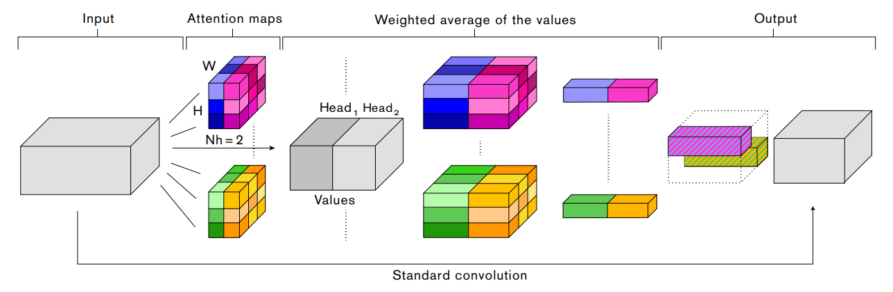
Overall Architecture

Slide 18
Overall Architecture

Slide 19
Overall Architecture
Attention Maps

Slide 20

Overall Architecture
Attention Maps
Notes:
Concatenate + reshape

Slide 21
Overall Architecture
Attention Maps
Notes:
Concatenate + reshape

Slide 22

Overall Architecture
Attention Maps
Notes:
Concatenate + reshape

Slide 23

Overall Architecture
Attention Maps
Notes:
Concatenate + reshape

Slide 24
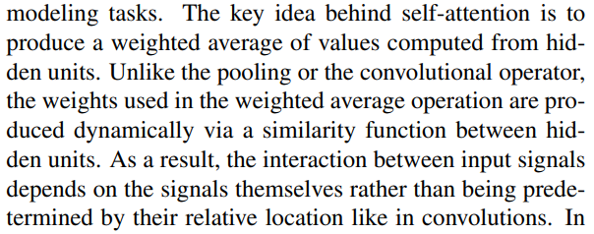
Overall Architecture (Question)

Slide 25
Experiments
Images classification (with ResNet, with MnasNet)
Object detection (with Resnet)
Notes:
In the subsequent experiments, we test Attention Augmentation on standard computer vision architectures such as ResNets [14, 47, 13], and MnasNet [42] on the CIFAR100 [22], ImageNet [9] and COCO [25] datasets. Our experiments show that Attention Augmentation leads to systematic improvements on both image classification and object detection tasks across a broad array of architectures and computational demands. W

Slide 26
Future work
fully attentional regime
how different attention mechanisms trade off computational efficiency versus representational power
if using Attention Augmentation as a primitive in automated architecture search procedures proves useful to find even better models
which degree fully attentional models can replace convolutional networks for visual tasks.
Notes:
Several open questions from this work remain. In future work, we will focus on the fully attentional regime and explore how different attention mechanisms trade off computational efficiency versus representational power. For instance, identifying a local attention mechanism may result in an efficient and scalable computational mechanism that could prevent the need for downsampling with average pooling. Additionally, it is plausible that architectural design choices that are well suited when exclusively relying on convolutions are suboptimal when using self-attention mechanisms.

Slide 27
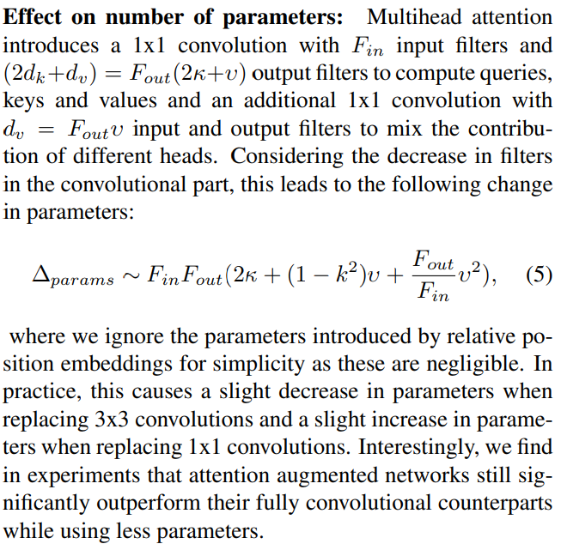
Questions

Slide 28
Most notably, Bahdanau et al. [2] first proposed to combine attention with a Recurrent Neural Network [15] for alignment in Machine Translation. Attention was further extended by Vaswani et al. [43], where the self-attentional Transformer architecture achieved state-of-the-art results in Machine Translation. Using self-attention in cooperation with convolutions is a theme shared by recent work in Natural Language Processing [49] and Reinforcement Learning [52].

Slide 29
In non-local neural networks [45], improvements are shown in video classification and object detection via the additive use of a few non-local residual blocks that employ self-attention in convolutional architectures. However, nonlocal blocks are only added to the architecture after ImageNet pretraining and are initialized in such a way that they do not break pretraining.
In contrast, our attention augmented networks do not rely on pretraining of their fully convolutional counterparts and employ self-attention along the entire architecture.

Slide 30
The use of multi-head attention allows the model to attend jointly to both spatial and feature subspaces. Additionally, we enhance the representational power of self-attention over images by extending relative self-attention [37, 18] to two dimensional inputs allowing us to model translation equivariance in a principled way. Finally our method produces additional feature maps, rather than recalibrating convolutional features via addition [45, 53] or gating [17, 16, 31, 46]. This property allows us to flexibly adjust the fraction of attentional channels and consider a spectrum of architectures, ranging from fully convolutional to fully attentional models.

